Slide 1
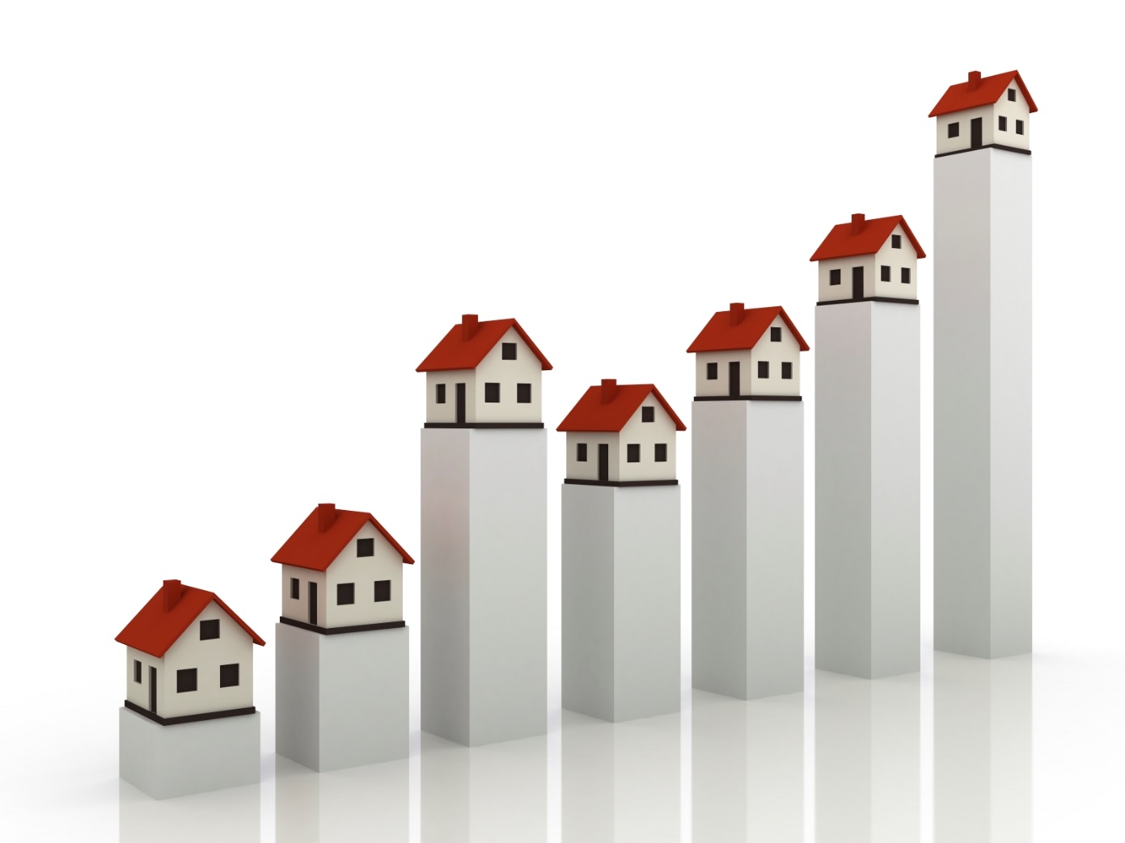
House Price Prediction Using Machine and Deep Learning
Introduction to Big Data Final Project
Abdallah Tamer Mohamed El Gahmry
Dr. Mustafa Abdul Salam

Slide 2

Team Members
Abdallah Tamer Mohamed El Gahmry CS
Mohamed Elsayed Salah Abo Heiba SC
Eman Nasser Abdel Hafaz Ahmed SC
Ali Hamdy Ali Hassan Harazon CS

Slide 3
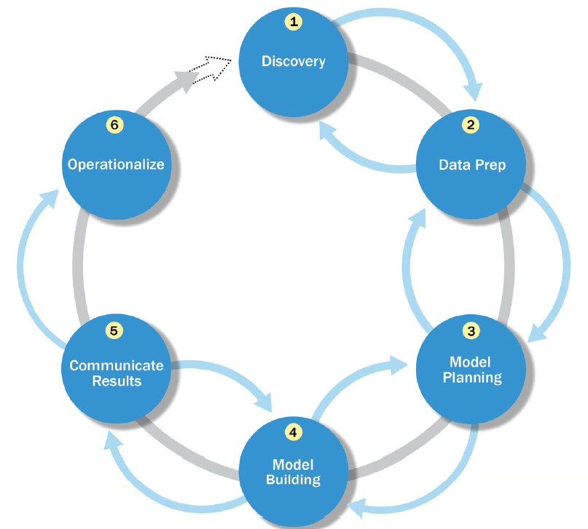
Data Analytics Lifecycle

Slide 4
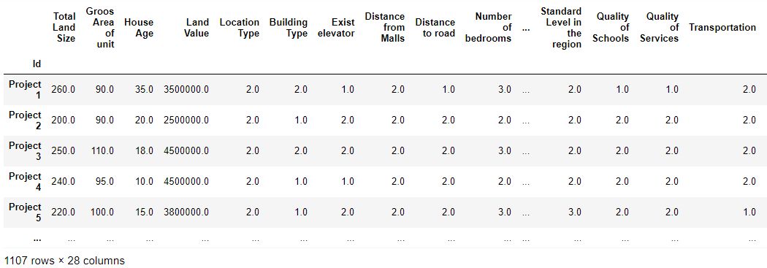
Phase 1: Discovery
There are 1107 records with 27 features for each.
The output of the model should be the price of a house given the features of the house.
The problem is a regression problem.

Slide 5
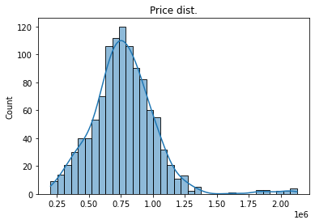
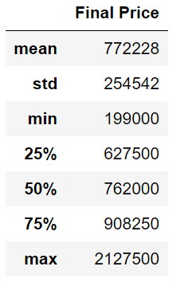
Phase 1: Discovery
The maximum price is 2127500 L.E.
The minimum price is 199000 L.E.
The average price is 772228 L.E.

Slide 6
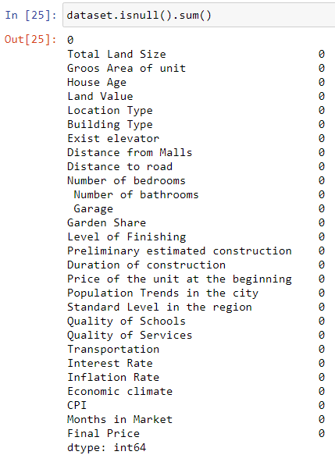
Phase 2: Data Preparation - Taking care of missing data

Slide 7
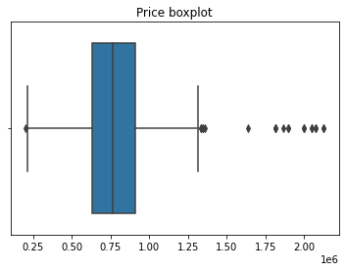
Phase 2: Data Preparation - Removing outliers
The following figures shows that there are some outliers in the dataset.

Slide 8
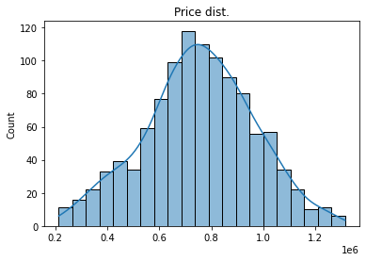
Phase 2: Data Preparation - Removing outliers
The figure shows the distribution of the prices after removing the outliers from the dataset.

Slide 9
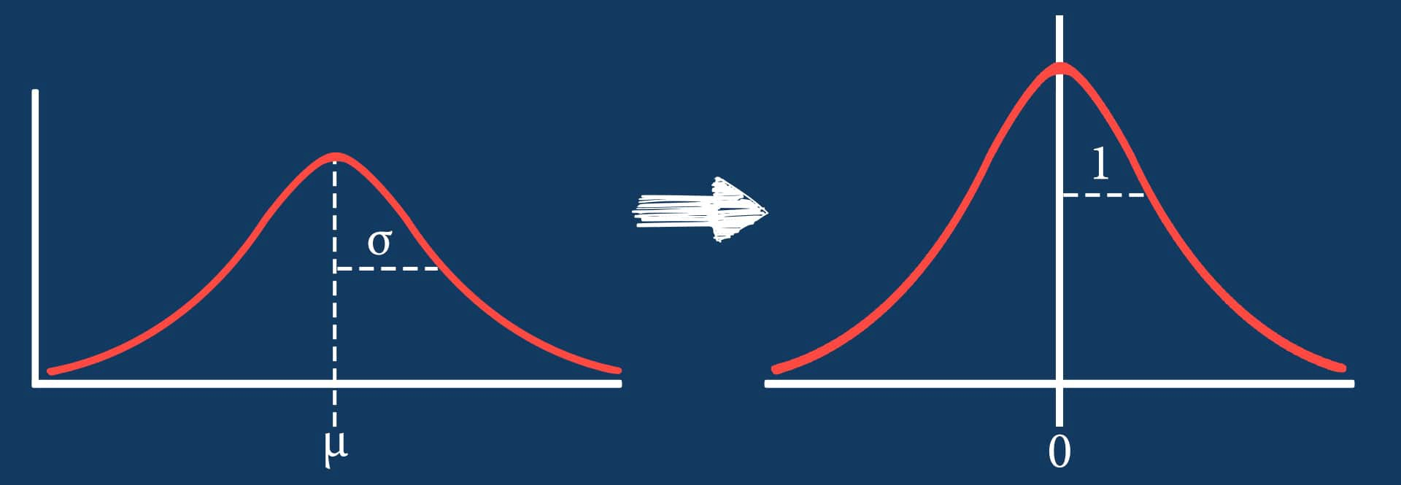
Phase 2: Data Preparation - Feature Scaling
It is performed during the data pre-processing to handle highly varying values.
Standardization is a very effective technique which re-scales the values so that it has distribution with 0 mean value and variance equals to 1.

Slide 10
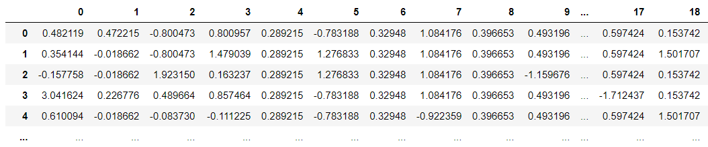
Phase 2: Data Preparation - Feature Scaling
Data before scaling
Data after scaling

Slide 11

Phase 2: Data Preparation – Data Splitting
Dataset is splitted as:
80% for training.
20% for testing.

Slide 12
Phase 3: Model Planning
The candidate machine and deep learning models to apply to the data for regression:
Support Vector Machine (SVM)
K-Nearest Neighbors (KNN)
Multi Layer Perceptron (MLP)
Artificial Neural Networks (ANNs)
Convolutional Neural Networks (CNNs)
Long Short-Term Memory (LSTM) Networks
Gated Recurrent Units (GRUs) Networks
LightGBM
CatBoost

Slide 13
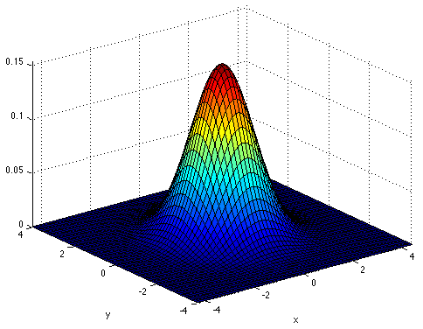
Phase 4: Model Building – SVM Hyper-parameters Tuning
The best parameters are obtained by using the grid search.
Parameter | Value
Kernel | RBF
C | 10

Slide 14
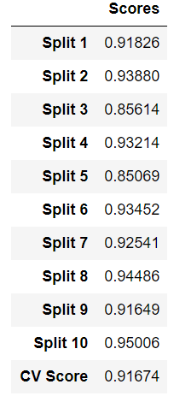
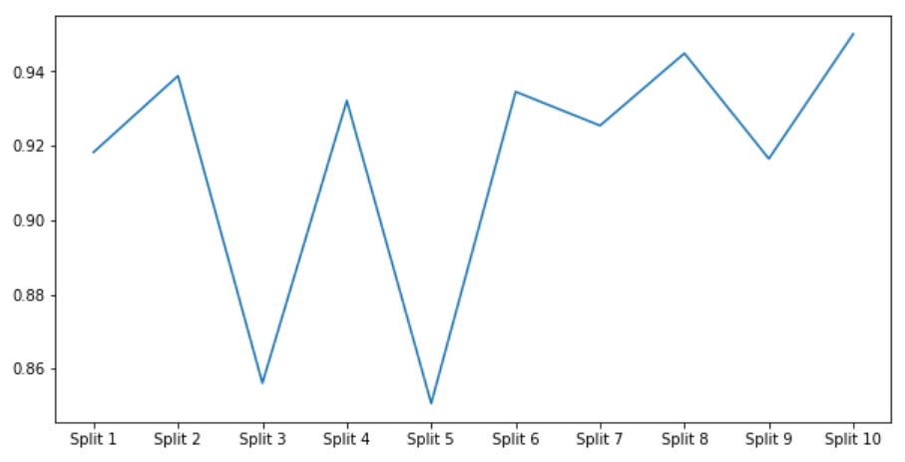
Phase 4: Model Building – SVM Cross Validation Score

Slide 15
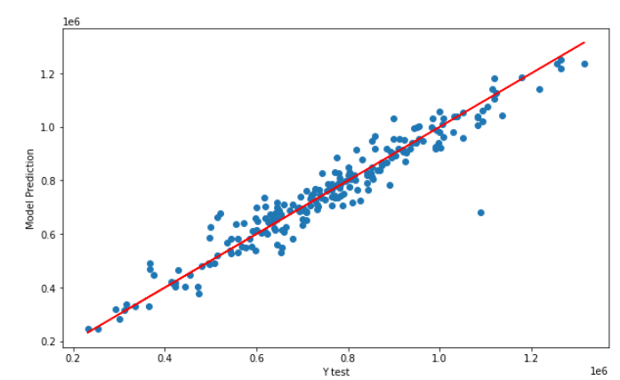
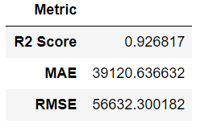
Phase 4: Model Building – SVM Performance on the Testing Data

Slide 16
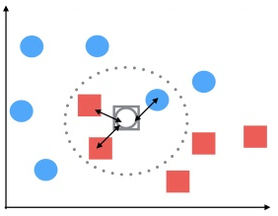
Phase 4: Model Building – KNN Hyper-parameters Tuning
The best parameters are obtained by using the grid search.
Parameter | Value
Metric | Manhattan Distance
Neighbors | 2
P | 2
Weights | Distance

Slide 17
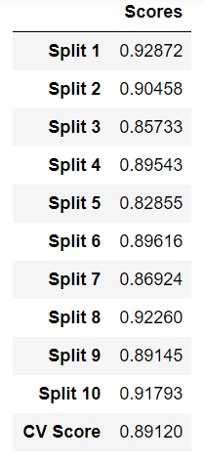
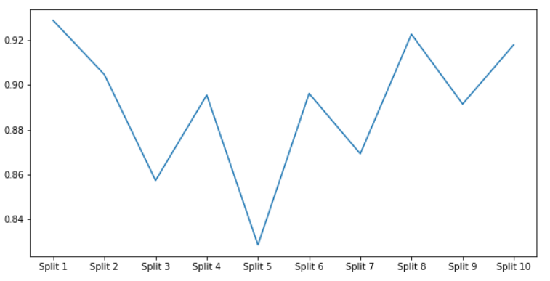
Phase 4: Model Building – KNN Cross Validation Score

Slide 18
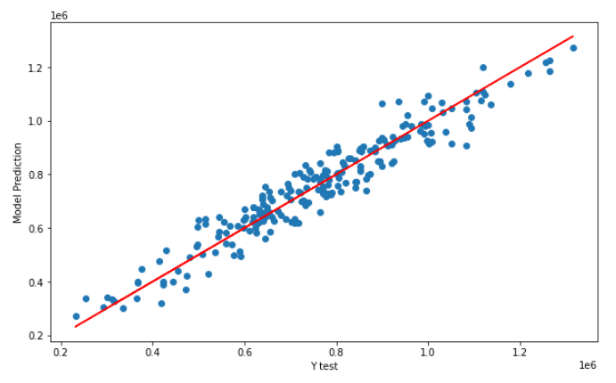
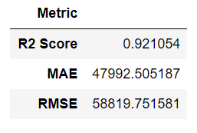
Phase 4: Model Building – KNN Performance on the Testing Data

Slide 19
Phase 4: Model Building – MLP Hyper-parameters Tuning
The best parameters are obtained by using the grid search.
Parameter | Value
Activation | Tanh
Optimizer | Adam
Hidden Layer Size | 100

Slide 20
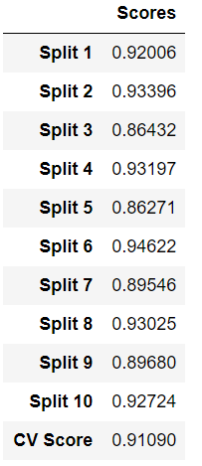
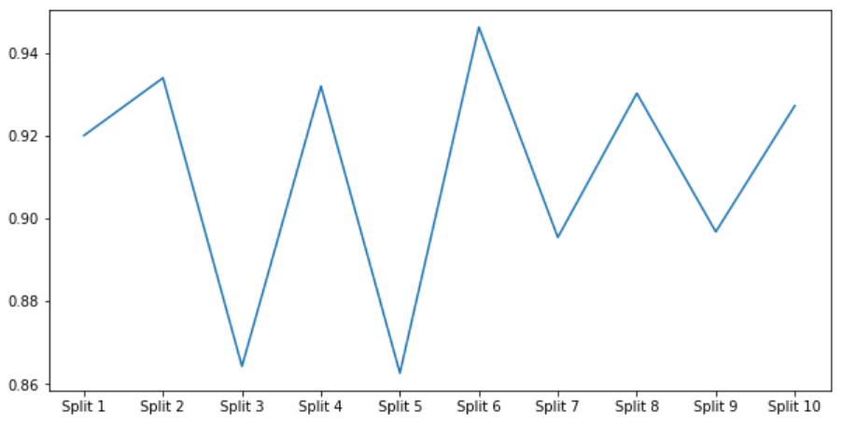
Phase 4: Model Building – MLP Cross Validation Score

Slide 21
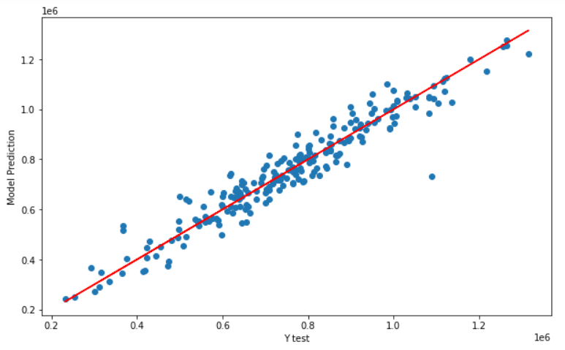
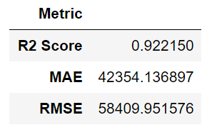
Phase 4: Model Building – MLP Performance on the Testing Data

Slide 22
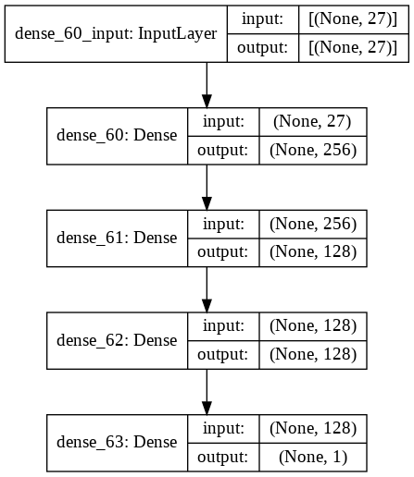
Phase 4: Model Building – ANN
Optimizer: RMSprop
Epochs: 100
CV Score: 0.91381

Slide 23
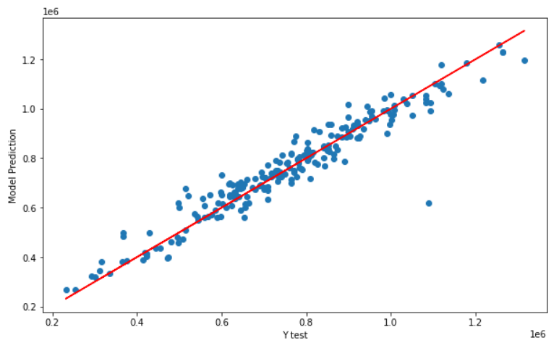
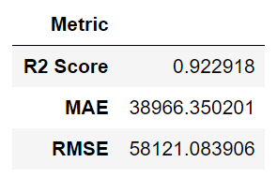
Phase 4: Model Building – ANN Performance on the Testing Data

Slide 24
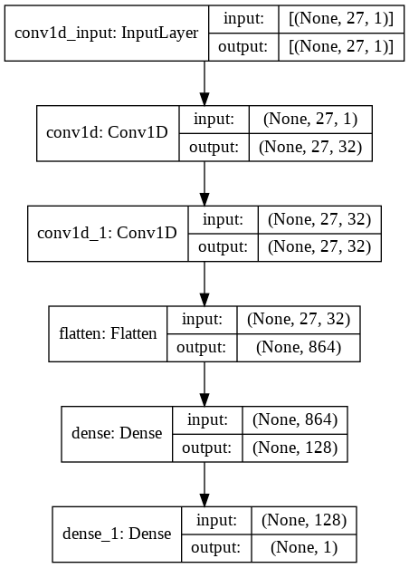
Phase 4: Model Building – CNN
Optimizer: Adam
Epochs: 195
CV Score: 0.91045

Slide 25
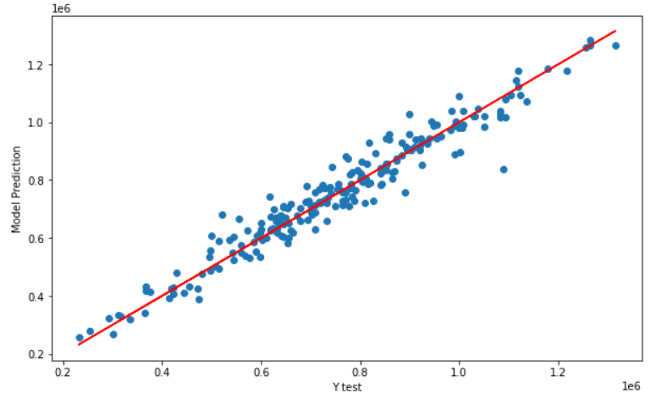
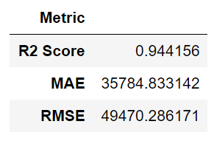
Phase 4: Model Building – CNN Performance on the Testing Data

Slide 26
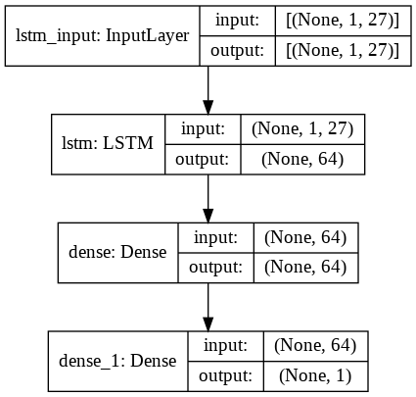
Phase 4: Model Building – LSTM
Optimizer: Adam
Epochs: 200
CV Score: 0.90011

Slide 27
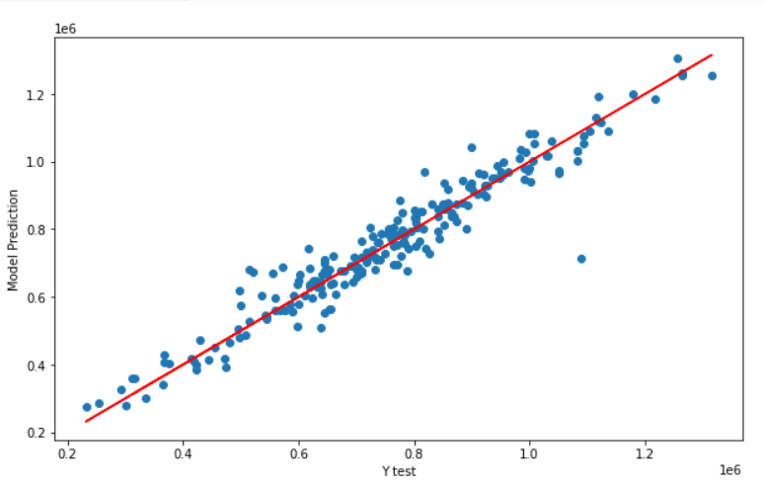
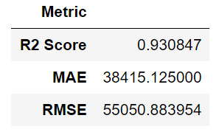
Phase 4: Model Building – LSTM Performance on the Testing Data

Slide 28
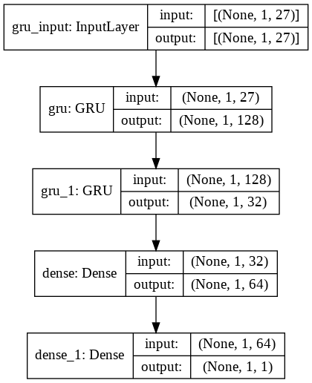
Phase 4: Model Building – GRU
Optimizer: Adam
Epochs: 200
CV Score: 0.90576

Slide 29
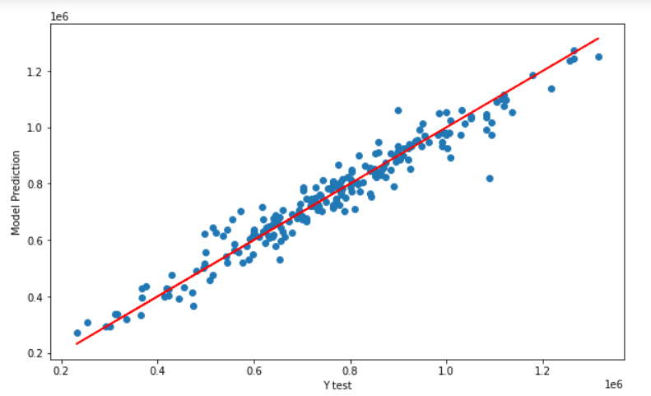
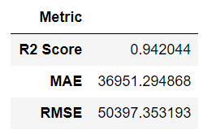
Phase 4: Model Building – GRU Performance on the Testing Data

Slide 30
Phase 4: Model Building – LGBM Hyper-parameters Tuning
The best parameters are obtained by using the grid search.
Parameter | Value
Booster | gbtree
Feature fraction | 0.5
Learning rate | 0.05
Estimators | 1000
Num leaves | 31
Reg alpha | 0.1
Bagging fraction | 0.75

Slide 31
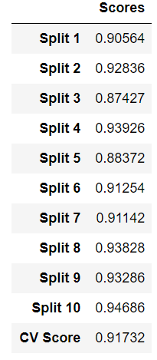
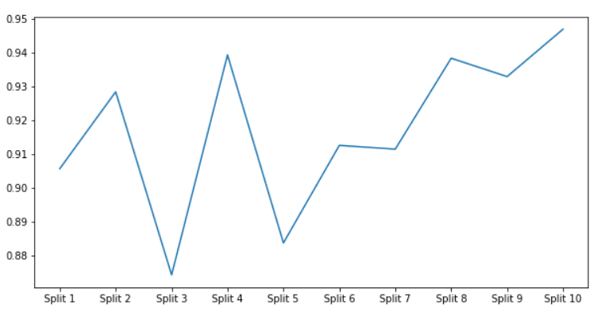
Phase 4: Model Building – LGBM Cross Validation Score

Slide 32
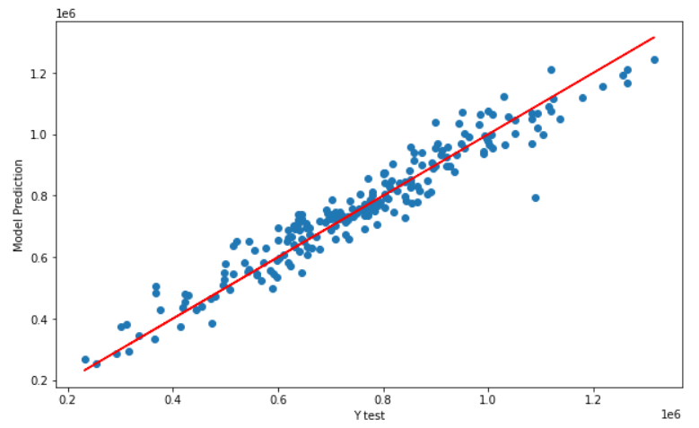
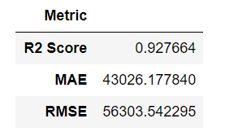
Phase 4: Model Building – LGBM Performance on the Testing Data

Slide 33
Phase 4: Model Building – CatBoost Hyper-parameters Tuning
The best parameters are obtained by using the grid search.
Parameter | Value
Iterations | 2000
Loss function | RMSE
Depth | 6
Border count | 64
L2 leaf reg | 3

Slide 34
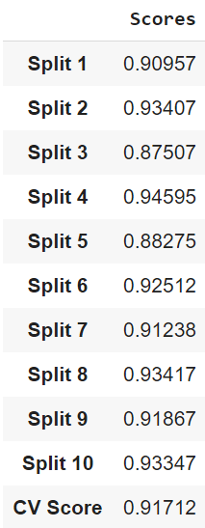
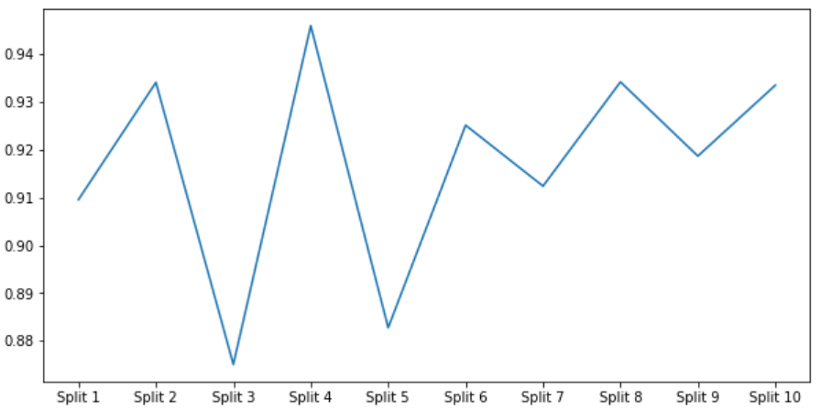
Phase 4: Model Building – CatBoost Cross Validation Score

Slide 35
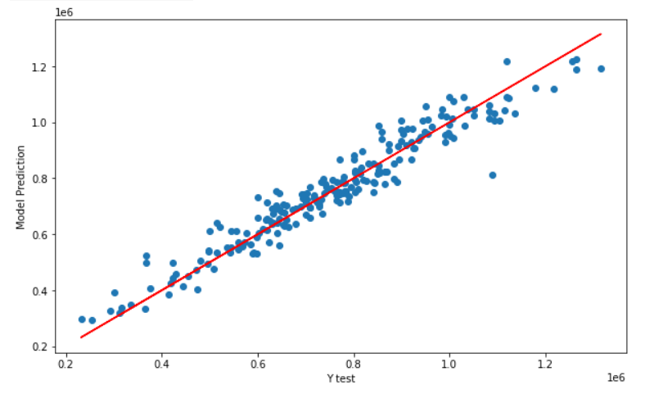
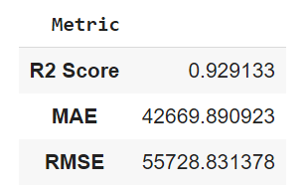
Phase 4: Model Building – CatBoost Performance on the Testing Data

Slide 36
Phase 5: Communicate Results
The CNN model achieves the best R-squared, MAE, and RMSE.
The LGBM model achieves the best CV score.
Model | CV Score | R-Squared | MAE | RMSE
SVM | 0.91674 | 0.926817 | 39120.64 | 56632.300
KNN | 0.89120 | 0.921054 | 47992.51 | 58819.751
MLP | 0.91090 | 0.922150 | 42354.14 | 58409.952
ANN | 0.91381 | 0.922918 | 38966.35 | 58121.084
CNN | 0.91045 | 0.944156 | 35784.83 | 49470.286
LSTM | 0.90011 | 0.930847 | 38415.125 | 55050.884
GRU | 0.90576 | 0.942044 | 36951.295 | 50397.353
LGBM | 0.91732 | 0.927664 | 43026.178 | 56303.542
CatBoost | 0.91712 | 0.929133 | 42669.891 | 55728.831

Slide 37


